Slide 1
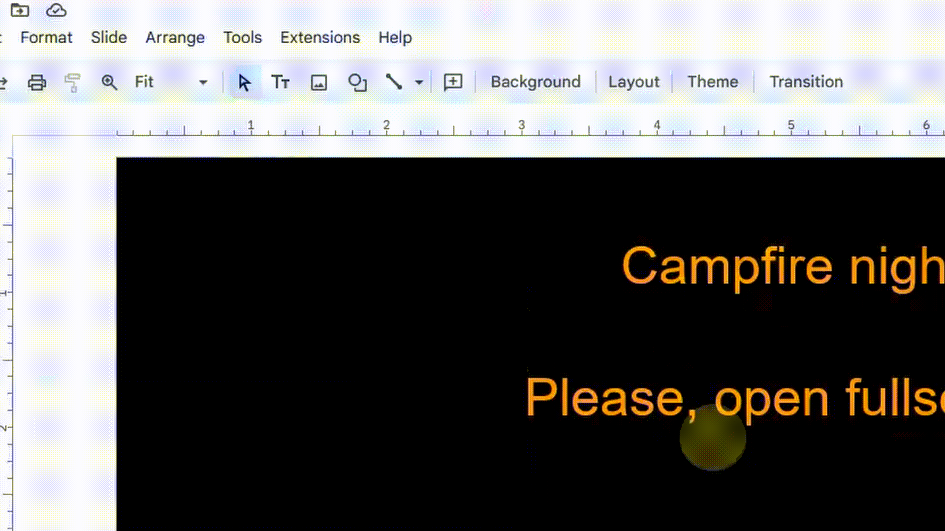
The campfire presentation story
Please, open fullscreen

Slide 2



Please, Open full mode for better experience
Instruction for game: Click in option sample:
Easy. No music in this place…
Here is the sample
Unfortunately, the pdf file does not contain sound. Therefore, on the project website there is a link to the online version, where you can feel a different atmosphere of the game when you put the presentation in presentation mode
Got it

Slide 3
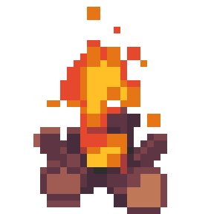
This is NOT the button:
Remember, Instruction: Click in option sample like this:
Here is the sample
Easy. No music in this place… But next You should hear something
Start game

Slide 4

For a moment, you feel like you can't hear anything. Your thoughts arrive hard, as if through a fog.... But after a while everything returns to normal
You begin to hear the sound of some animal. You are sitting by a campfire at the same time and it is the only bright spot in this dark area
Make a torch
Wait a little

Slide 5

You threw the potion directly at the target and whatever was about to appear evaporated. The only thing left was the glass from the broken potion. You walked closer and noticed the label. You hadn't noticed it before. The inscription on it proclaimed: invisibility potion.... Fortunately, it was just a bad dream
You begin to hear the sound of some animal. You are sitting by a campfire at the same time and it is the only bright spot in this dark area
Make a torch
Wait a little
Wait a little

Slide 6
Fortunately, it was just a bad dream
You begin to hear the sound of some animal. You are sitting by a campfire at the same time and it is the only bright spot in this dark area
Make a torch
Wait a little
Wait a little

Slide 7
Oh.. I can time manipulation...
You begin to hear the sound of some animal. You are sitting by a campfire at the same time and it is the only bright spot in this dark area
Make a torch
Wait a little

Slide 8
You do not feel the need to leave the campfire. At some point, it began to die down. The sounds also... disappeared. More specifically, the ambient sounds have disappeared
You see something heading in your direction. It seems to you that this something has hostile intentions. What do you do?
Defend yourself with an unidentified potion
Wait a little more
Make a torch

Slide 9

Nothing to spot here. Wait a second, here. Take this goose with You. You two look… similiar
This is Your achievement for this ending. Good luck!
Stage Achievment
Seriously!?
What the duck?

Slide 10

You took the torch. Information began to flow into your head. You have a chance to either remember the past or create a new future.
Great. This torch is my inspiration!
I want future!
I want explore my past

Slide 11

You decide to write a game that does not require an engine. You look for an alternative method... It turns out to be a good choice in the future. You collect more and more achievements for your work. You are just standing at the gala. There is someone walking towards you with a trophy. You extend a wing in his direction.... Wait, a wing?
Ending #1
This is Your achievement for this ending. Good luck!
Be number one!

Slide 12

The torch is burning and with the light in your mind your image is slowly forming. Indistinct, blurry. It seems to you that you are being made for great things. I think. The torch burns out more and more. Will you let it work on you longer?
I was made for great things.
I’m in
Meh, I don’t wanna

Slide 13


This is Your achievement for this ending. Good luck!
If a certain rat didn't want to cook and get lost in the sewers..., then we would not have had an interesting story. That is exactly what happened at this point. Maybe that's a good thing, too?
Ending #5
But I don’t wanna

Slide 14
It comes to you that you are the ancient god. All this time you've only been asleep. Eons have passed and everyone has forgotten about you.
Time for me to return in my glory place

Slide 15
You have succeeded in whispering to stir up the beginnings of faith where it is needed. In a few places you had to reveal yourself. Surrounded on all sides by praise, you begin to brood over it. They praise you because of the fact that they like you.... Or perhaps because of your great looks that won't let you look away from the mirror?
I must focus on people
I’m cutest in the world

Slide 16
You have that thing about you: a sparkle in your eye, so that if you show yourself to any man, he will immediately smile and fall at your service. And what’s more, YOU ARE GOD! But first you have to make yourself known. The question is, is it worth it? Do you want to punish those who have forgotten you? Or will you gather followers anew?
I'm afraid that someday they will forget about me again Time for revenge
Accept them as my followers

Slide 17
Well, not everyone is so receptive to your call. Some people don't believe in you, even when you specifically informed them about it.
I will not forgive atheists for not believing in me
I am a loving deity. They have free will

Slide 18
Nothing works better for renewing faith than to walk over to an atheist and break the windows in his house ^^
This has calmed your anger a bit
I don't want to waste my time on them
Hmpfff. That should be enough

Slide 19
Your blink of an eye takes several years in the mortal world. If you weren't looking, there were rats on the surface.... That is, minor deities who want to steal Your glory and claim people for themselves
Let the gods pay me a tribute. I was the first
All in all, a little mischief can't hurt

Slide 20

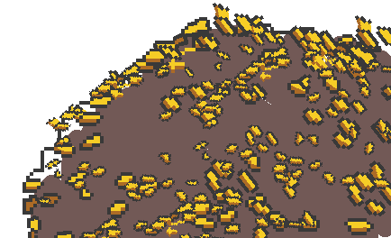
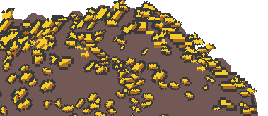
This is Your achievement for this ending. Good luck!
Nothing sounds better to you than the buzz of cash. Right?
Ending #6
MeowCoin

Slide 21
The noise you make takes away sleep for the being called human. People can't get a wink of sleep. Slowly to the heavens they begin to pray to whatever they can for peace and sleep
Whisper something bad to half of the lives
Start making a lot of noise

Slide 22
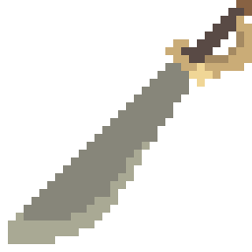
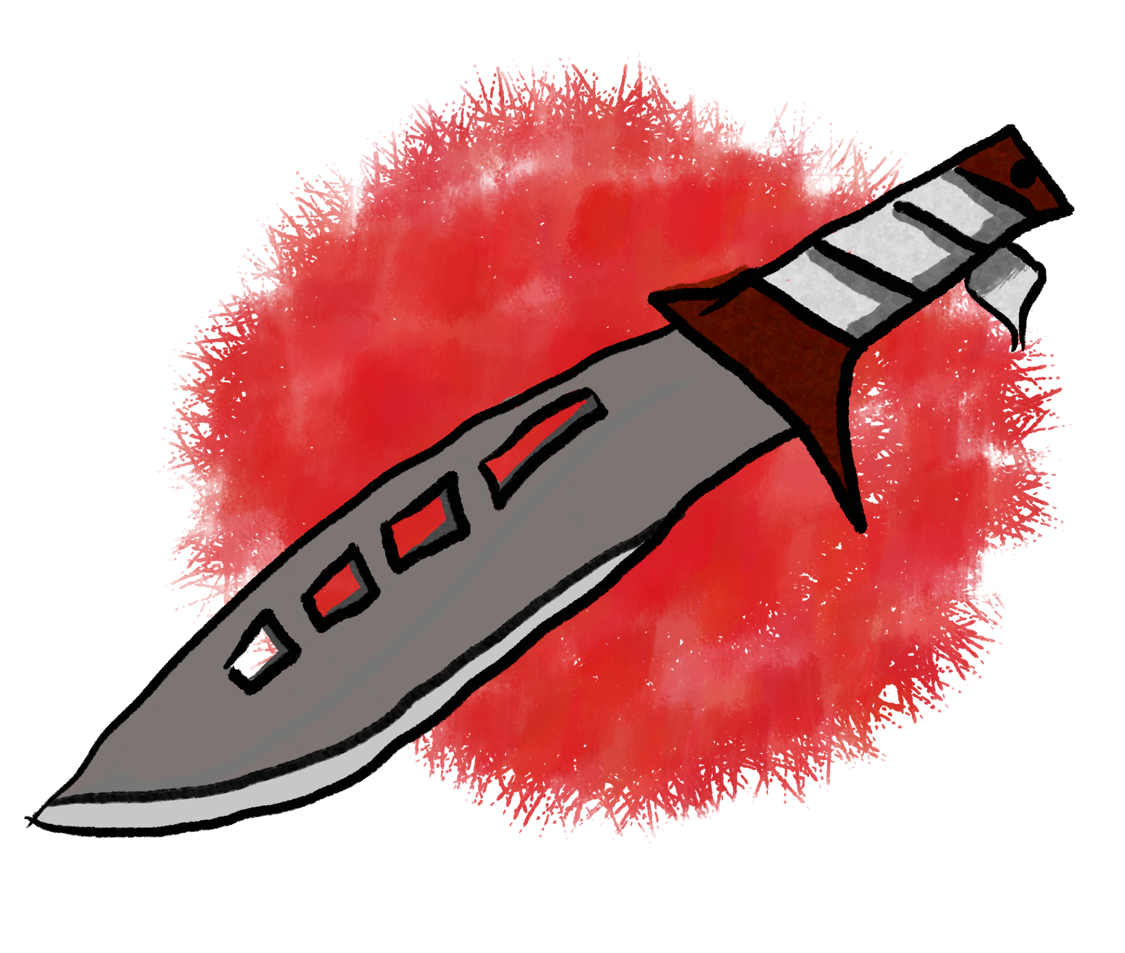
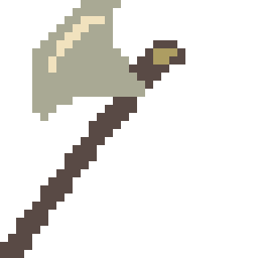

This is Your achievement for this ending. Good luck!
You send a message to all living creatures:
“you were right. Only your faith makes sense and others were wrong. You have all my support. I want you to weed out the heretics.
Go on a crusade in my name!”
Ending #4
Deus Vult

Slide 23

This is Your achievement for this ending. Good luck!
Your loud voice carries over mountains, forests and valleys. No one is able to find you. No one is able to silence you. You watch as these strange two-legged creatures lie down on the ground and don't get up again. Now it's time for you to create something new. Preferably in your own image. You begin to stick a new life out of clay.
Ending #3
HONKalypse

Slide 24

Oh, what a wonderful existence I am. I can look at myself in the reflection of the water indefinitely. Just me and my reflection. Forever. A reflection that only the stars and the moon will remember, as long as they exist in this darkness.
You freeze in time watching yourself in the sheet of water. How you look is in a class of its own
Ending #2
This is Your achievement for this ending. Good luck!
Narcissist duck

Slide 25
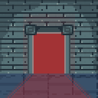
Sometimes when something different is chosen on the path of life, then the result changes a bit... And sometimes we still land in one place
Thank you for playing
Hmm… This portal looks strange. Maybe I need look closer?
Restart game
Bibliography?
Here

Slide 26
Bibliografy
Music and sfx: https://quicksounds.com/
Each Graphic
was handmade
“Engine”
Google Slides

